Slide 1
Forex Exchange Prediction
Presented By:
Tauseef Anjum Abdullah shahid
Irfan khaLid Usman Rasheed
Notes:
To change the image on this slide, select the picture and delete it. Then click the Pictures icon in the placeholder to insert your own image.

Slide 2
Problem Statement
Predict Market Performance for tomorrow (Loss/ Profit) (Classification)
Predict the exact value of profit/Loss (Regression)
Notes:
Predicting how the stock market will perform is one of the most difficult things to do. There are so many factors involved in the prediction – physical factors vs. physhological, rational and irrational behaviour, etc. All these aspects combine to make share prices volatile and very difficult to predict with a high degree of accuracy.

Slide 3
Proposed Solution
There are two types of approaches used to predict Forex
Fundamental Analysis
It involves economic indicators of one country like GDP, Inflation and Interest Rate.
Technical Analysis
It involves statistical methods like ARIMA and Machine Learning Models like Random Forest Classifier to identify trends in the market.

Slide 4
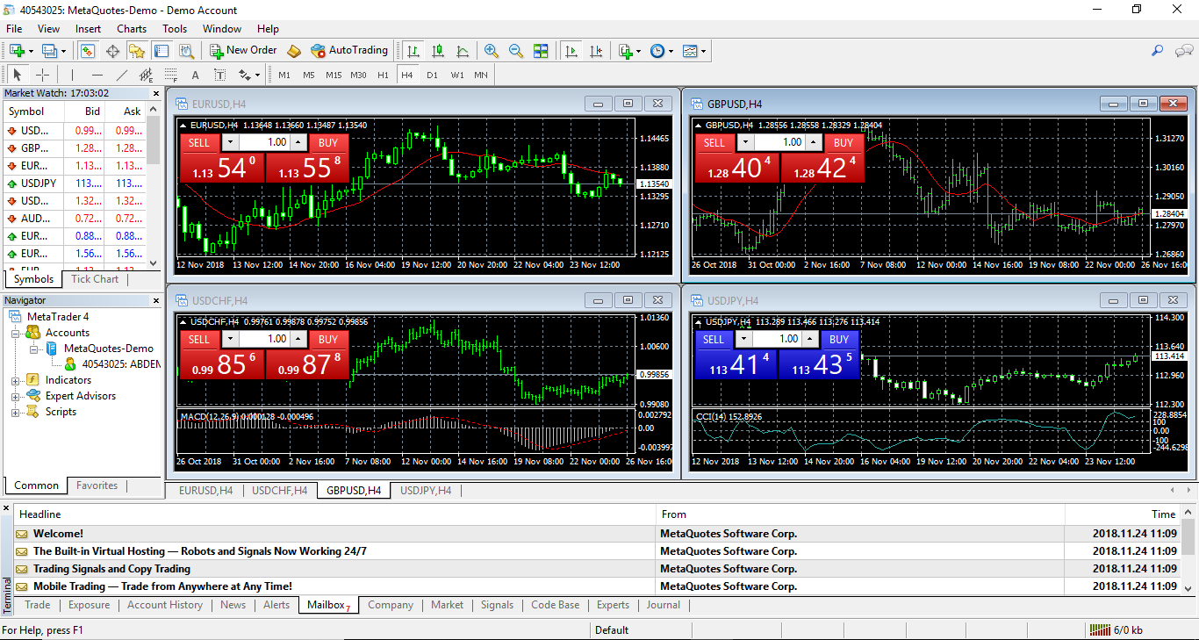
Data
Meta trader 4 is an online trading tool with a lot of statistical indicators.

Slide 5
Data Analysis & Pre-processing
There were no null values in dataset.
Data Attributes contain float values, Converted into integers by multiplying with suitable integers. Random Forest doesn’t accept float values.
Indicators like Simple Moving Average, Bollinger bands and Candle Stick is created in order to smooth curve and remove noise.

Slide 6
 | Time | Open | High | Low | Close | Volume
0 | 2012.12.10 | 1.04865 | 1.05049 | 1.04643 | 1.04868 | 59083
1 | 2012.12.11 | 1.04870 | 1.05315 | 1.04602 | 1.05266 | 61555
2 | 2012.12.12 | 1.05265 | 1.05848 | 1.05219 | 1.05531 | 68021
3 | 2012.12.13 | 1.05522 | 1.05628 | 1.05072 | 1.05264 | 66515
4 | 2012.12.14 | 1.05261 | 1.05770 | 1.05090 | 1.05651 | 68063

Slide 7
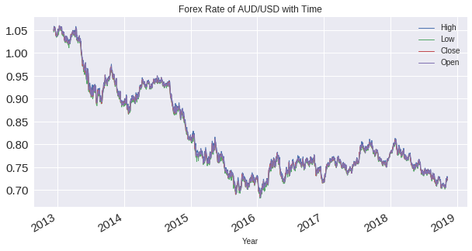
Data Analysis

Slide 8
Machine Learning Models
Random Forest Classifier
Test Score: 54.54 %
SVM
Test Score : 52 %

Slide 9
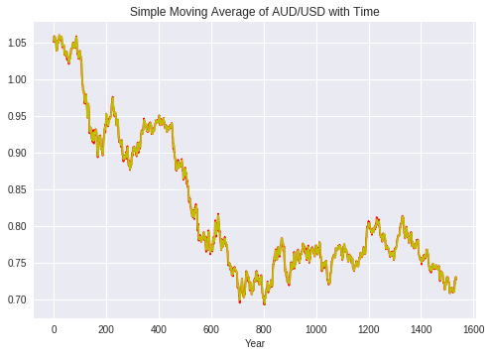
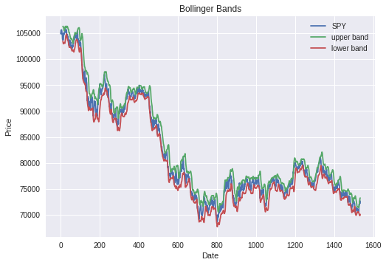
Statistical Indicators

Slide 10
Future Work
More Statistical Indicators to improve Algorithm’s performance.
Deep Learning Algorithm like LSTM (Long Short Term Memory) will be used to improve the prediction.

